Slide 2
AGENDA
9:00 | New business
9:20 | Sales & Marketing updates
9:30 | Internal updates
9:50 | Q&A
Notes:
Shape with edited points
Table

Slide 3
E-Commerce Opportunity
Notes:
Line chart, with “Percentage of Market” line made 100% transparent, so it doesn’t show up on the plot area

Slide 4
Leveraging E-Commerce
Online sales account for more than 50% of sales in most manufacturing areas
Expected to grow by more than 20% by 2021
Greatest opportunity is in software and cloud services
Expect 3D printing to gain momentum over next 5 years
Impact on several industries including printing, paper, machinery, and fabrication
Major growth opportunity for us

Slide 5
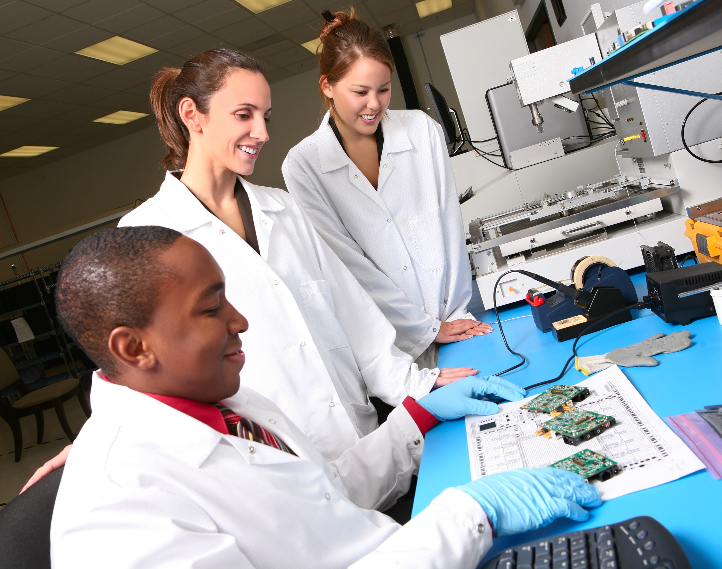
R&D Project Updates
DX-145 Drone (previously R-145) scheduled to release in Q1
RTE-QFN20 delayed due to increased materials demand – 2018 Q2 release

Slide 6
Rechargeable Battery Comparison
 | Lead Acid | Nickle Cadmium (NiCad) | Nickel-Metal Hydride (NiMH) | Lithium Rechargeable
Pros | High power density, wide temperature range | Wide temperature range, long shelf life, inexpensive | Lower cost, high current ability | High energy density, long lasting
Cons | Low energy density, heavy, large | High toxicity, low energy density | Can overcharge, short storage life | Expensive, require protection, ageing
Application | Battery banks, car batteries, golf carts, wheelchairs, electric scooters | Portable electronics, toys, cordless phones, remote controlled devices | Remote controlled devices, drones, portable devices, cameras | Cell phones, electronic watches, electric vehicles, laptops, power tools
Shelf Life | ~8 years | 1-3 years | ~3 years | ~3 years
Cycle Life | 200-300 cycles | 2,000 cycles | 800-2,000 cycles | 800-1,000 cycles

Slide 7

Sales and Marketing Updates

Slide 8
Jenny Torres
B2B Account Executive
Sharon Wu
Enterprise Sales Executive
Devon Harris Director of Sales & Marketing
Notes:
Smart art: alternating picture blocks

Slide 9
Q4 Sales

Slide 10
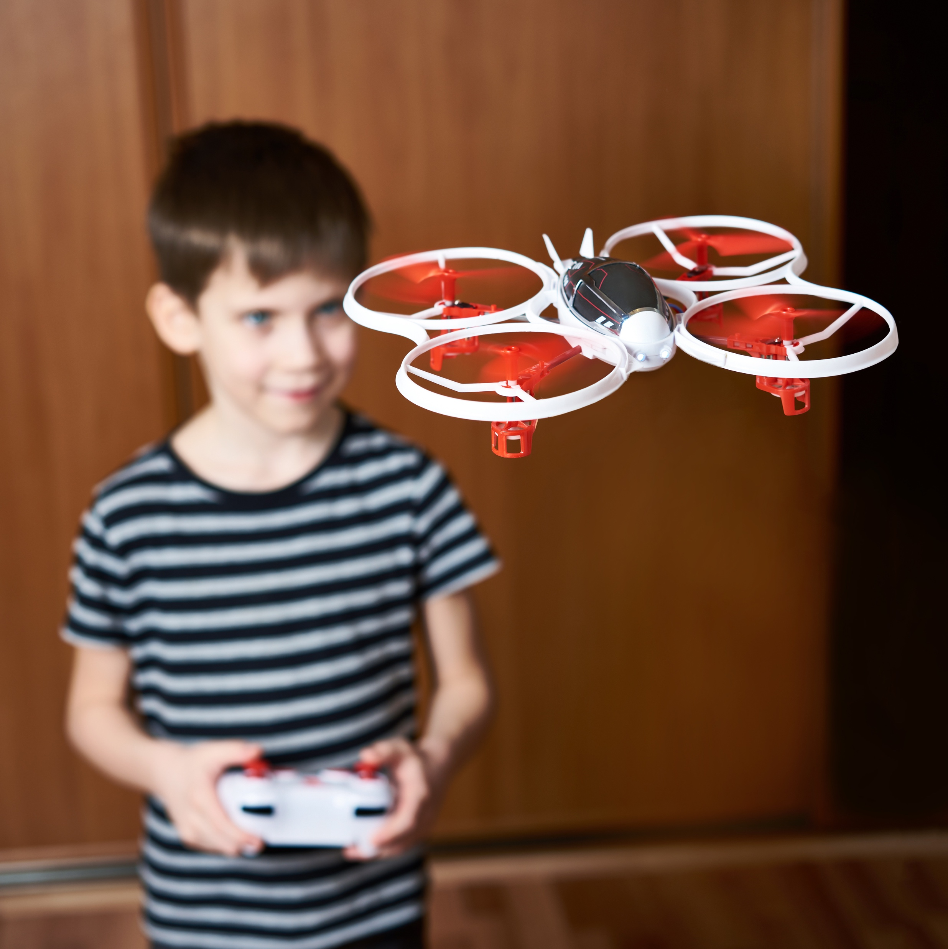
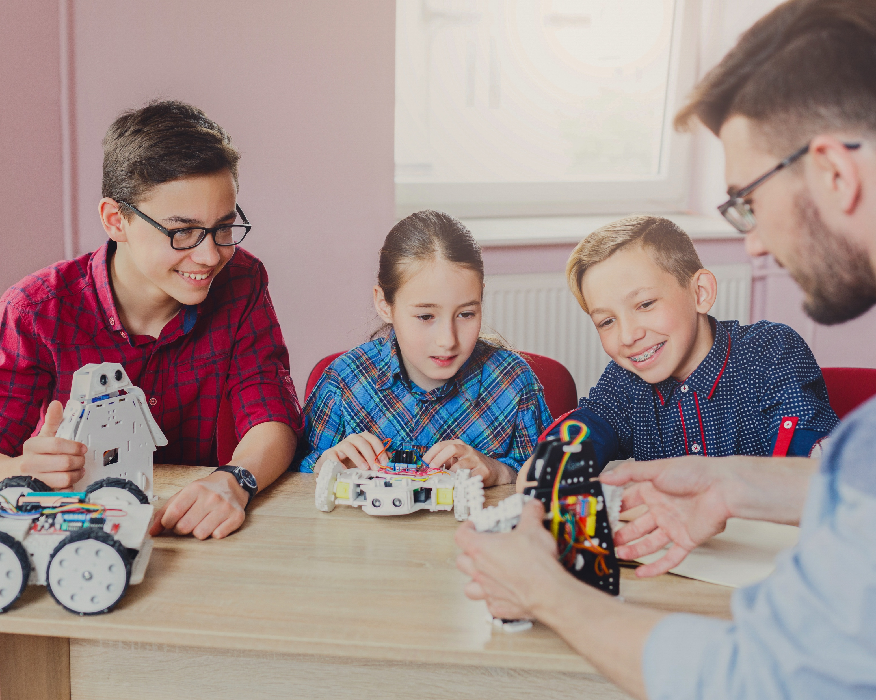
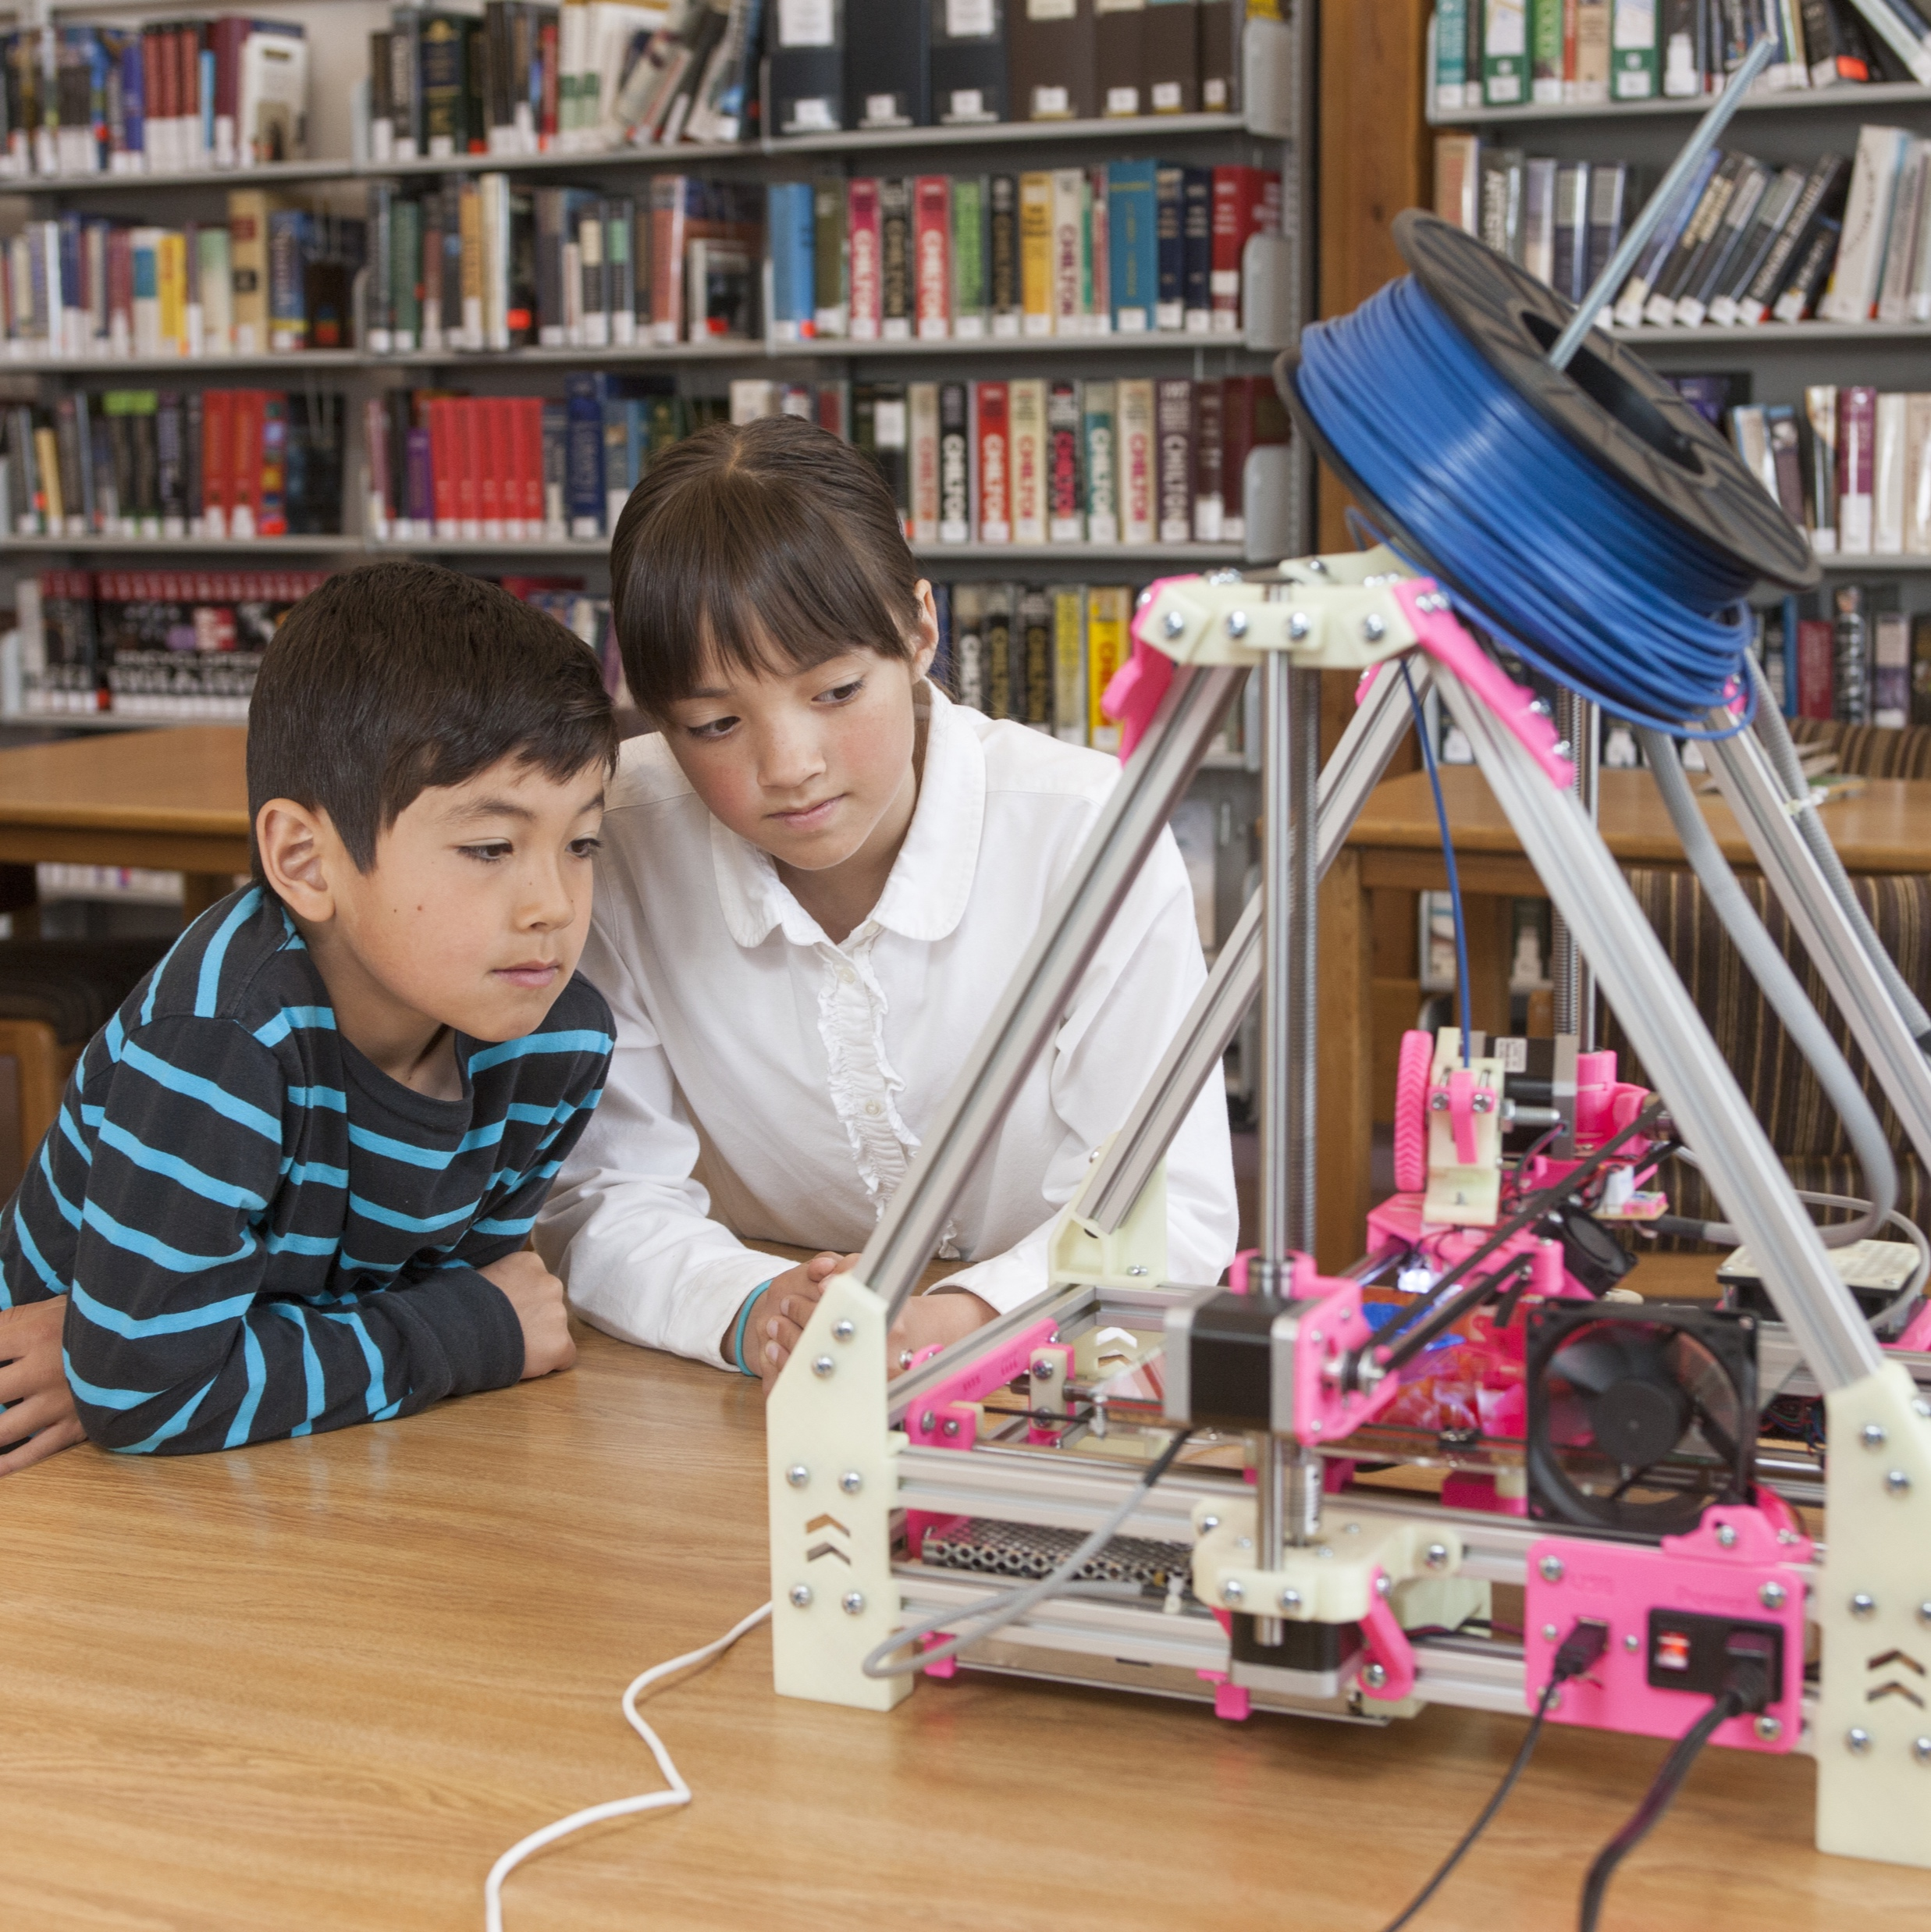
Project Orange STEM
Christopher tries out one of our assembled drones
Frank Smith showing students how to assemble a robot kit
Students watching 3D printer making figurine
Together with our partners at Orange Valley Schools we are working to introduce science, technology, engineering, and mathematics to children in our community.
E-mail projectorange@red30tech.com to find out about volunteer opportunities.
Notes:
Multi-photo slide with captions layout

